Slide 1
User Cancellation Avoidance
InFoMM Mini-Project
Victor Wang
Supervisor: Junaid Mubeen, Andrew Mellor(Oxford)

Slide 2
Agenda
Motivation and Goal
Background – Business Settings at Whizz
Model
Customer Journey
Methodology
Result
Clusters
Feature Analysis
Project Deliverables

Slide 3



Motivation and Goal
Retained customers create higher revenues
Making a sell to a new customer costs up to 5 times more.
Customer retention strategies targeting on high risk customers
Motivation
Goal – Churn (Cancellation) modelling
Who?
Identify customers most prone to cancel subscription
Assess likelihood
Why?
Analyse critical reason triggering cancellation
Enable to make bespoke retention policy

Slide 4




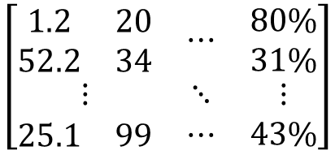
Business Settings at Whizz
Cancellation Mechanism
Contractual
Pupils subscribe to access Whizz products on a 1-month or 1-year contract
Voluntary
Subscribers make the choice to leave the service at the end of the subscription; otherwise auto-rolled
Data Records
Time period: 2014-Jan-01 – 2018-Apr-20
Features
Churn outcome
(renew / cancel)
Pupil
Subscription
Lesson History
$$\left[\begin{matrix}\begin{matrix}\begin{matrix}1.2 \\ 52.2\end{matrix} & \begin{matrix}20 \\ 34\end{matrix}\end{matrix} & ⋯ & \begin{matrix}80\% \\ 31\%\end{matrix} \\ ⋮ & ⋱ & ⋮ \\ \begin{matrix}25.1 & 99\end{matrix} & ⋯ & 43\%\end{matrix}\right]$$
$$\left[\begin{matrix}0 \\ \begin{matrix}1 \\ \begin{matrix}⋮ \\ 0\end{matrix}\end{matrix}\end{matrix}\right]$$
Renew
Pupil ID
Date of birth
Pupil ID
Start date
End date
Lesson ID
Pupil ID
Time
Mark
…
Cancel
5685 pupils
28025 subscriptions
~1.6 million lesson activities
Pass rate
Usage time
(hours)
Number of visits

Slide 5
Customer Journey
Pupils’ activities are split into monthly time periods with each customer-month represented by features.
Mar
Apr
May
Jun
Jul
Aug
Customer A
Calendar month
Customer B
Customer C
1
2
3
4
5
6
Customer A
Customer month
Customer B
Customer C
We assume the cancellation to be ONLY dependent on the current month.
The assumption holds since we observe statistically constant churn rate over customer month.
The assumption enables us to treat activities in different customer months indifferently.
Notes:
In order to construct the features grid, we need take a look at the customer journey first.
Each block represent an aggregate measure of features for a pupil within a month.
The customer journeys recorded in the calendar month coordinate are not comparable.
To make them comparable, we align them in the coordinate of customer month.

Slide 6
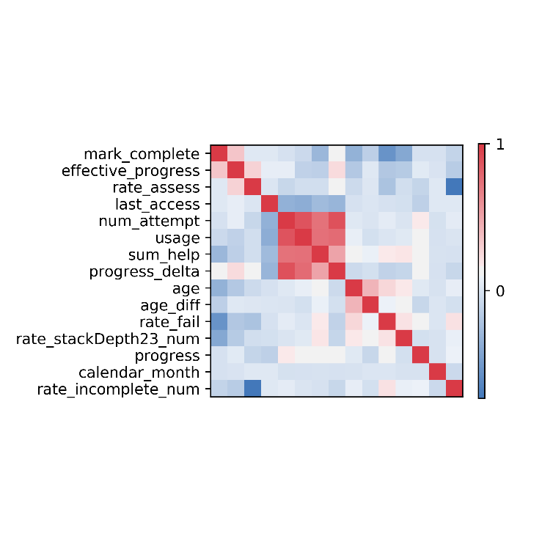
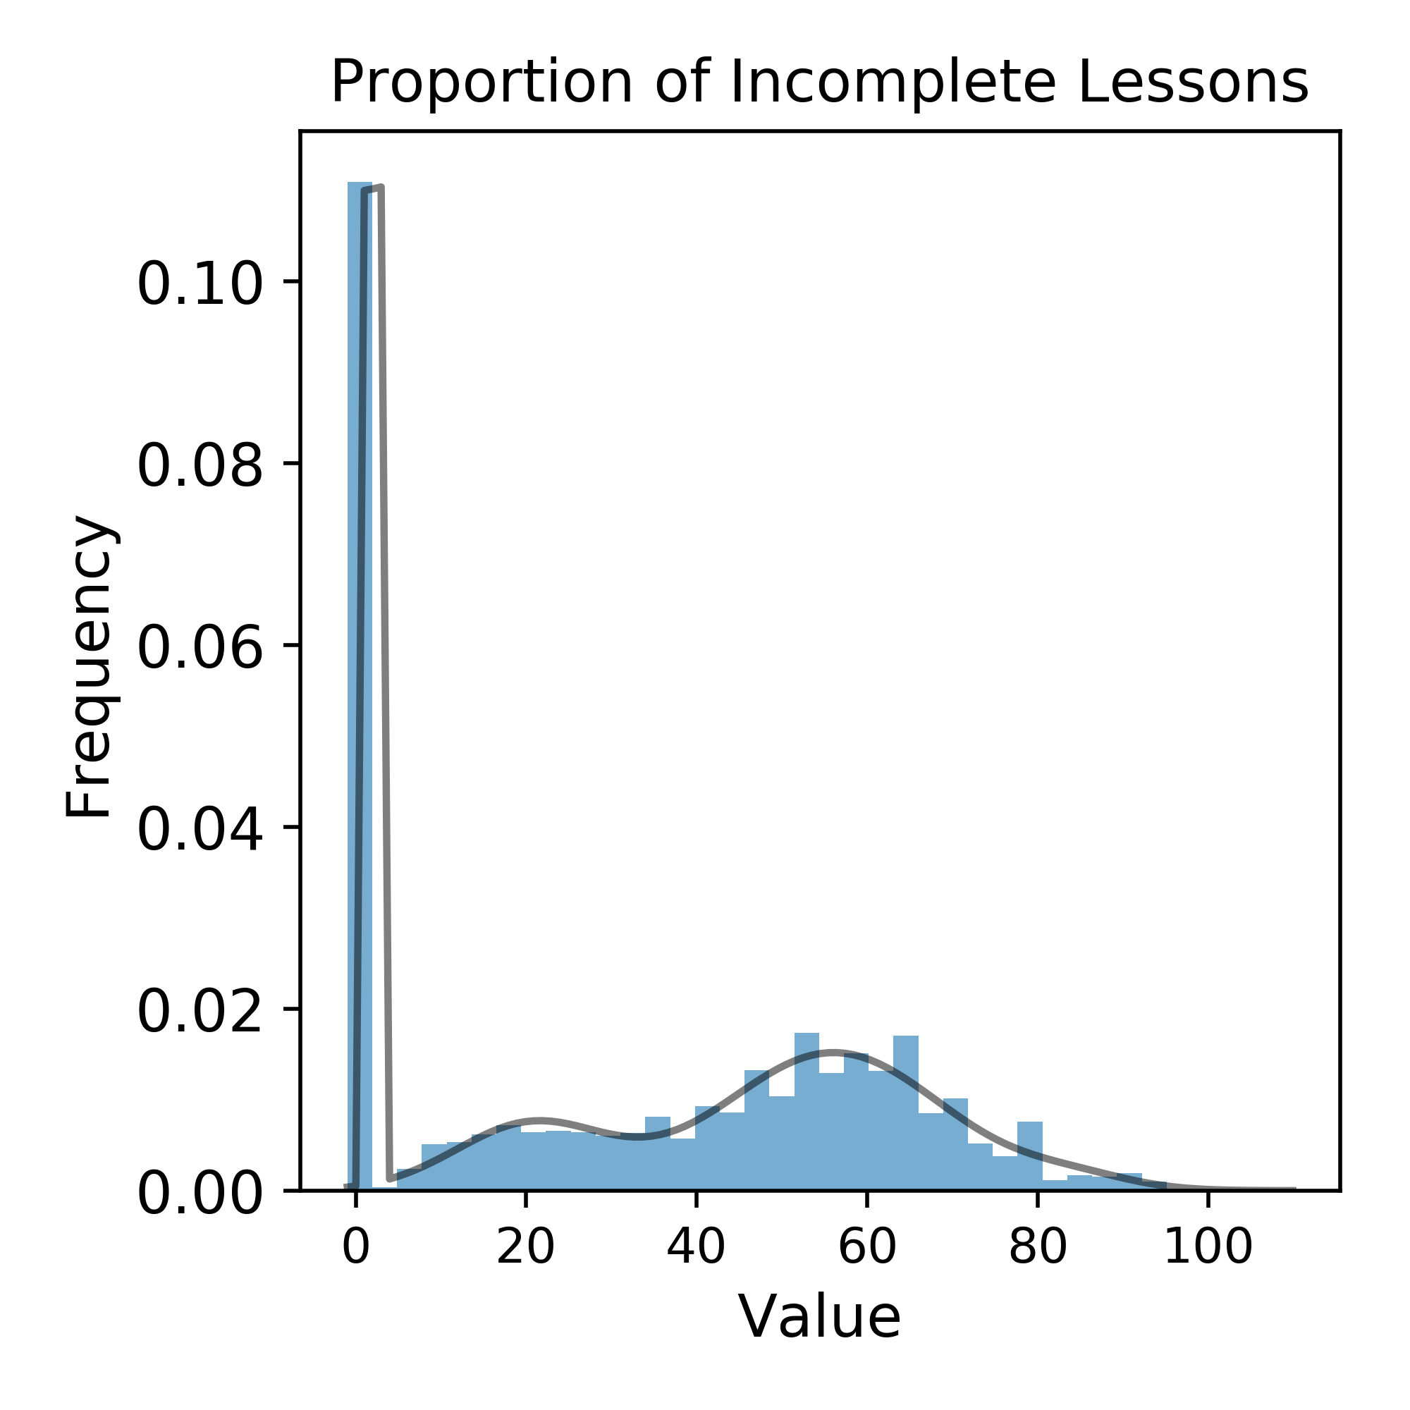
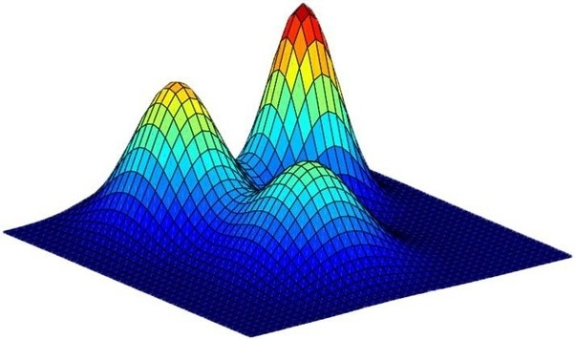
Methodology
Key Assumptions
Churners and non-churners exhibit different behaviours generated by some (hidden or observable) states
Each hidden state produces observable different sets of behaviours
Customers’ behaviours are independent from others’
Pipeline
Feature Extraction
Extract features to represent customers within a specific customer month.
Feature Distributional Modelling
Assess distributions, correlations, etc.
Clustering
Fit mixture model.
(EM-Algorithm, Baysian Inference)
Analytics and Prediction
Assess churn rate;
Interpret clusterings

Slide 7
A Closer Look at Clustering…
Different users will have different data available. For example, inactive users will have no records in features like marks, pass rates, etc.
Rather than interpolating missing information, we divide customers into groups by activity level.
Churn Rate
G1
Inactive
22.99%
(6417)
G1
Clusters
Inactive
No activity
G2
No-assess
16.94%
(425)
Fit
Mixture Model
G2
Clusters
There’s activity but no assessment
Most Active
G3
Fine
10.21%
(11019)
G3
Clusters
There’s activity and assessment taken

Slide 8
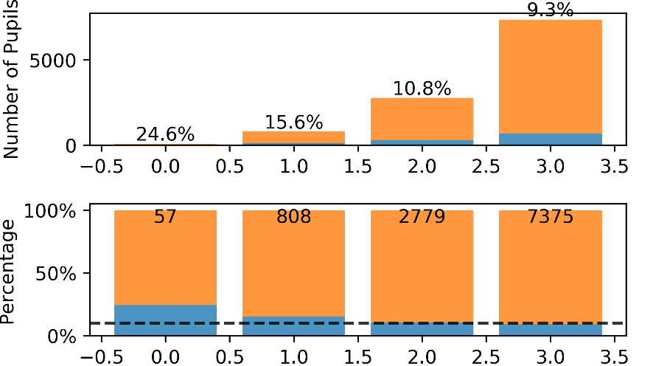
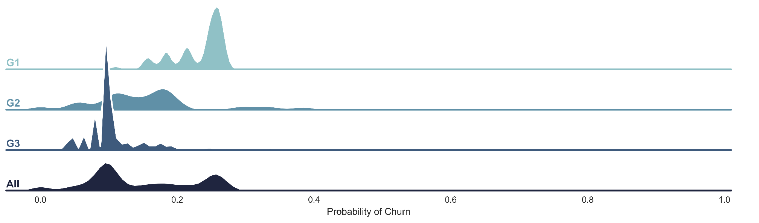
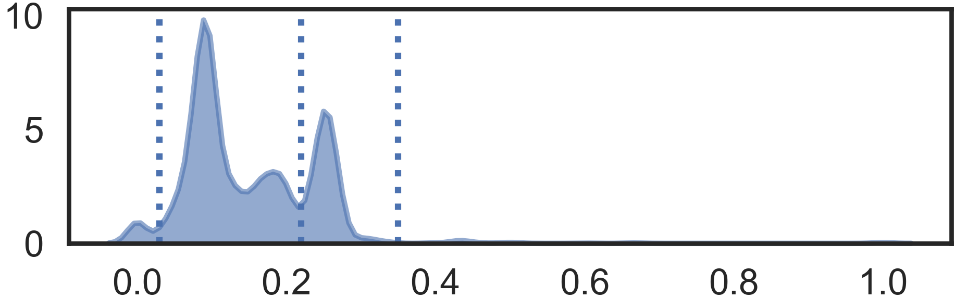
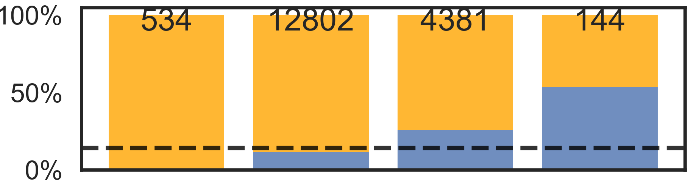
Cluster Churn (Who)
Example Analysis: Clusters Identified in G3 using 11 features
Observations:
The purely behaviour based model infers 4 clusters:
the highest churn rate is 2.5 times higher than the lowest one,
and 2.2 times higher than the group average.
It is more challenging to identify users of higher churn probability:
The higher rate, the smaller cluster is found.
From Cluster Churn Rate to Churn Probability of Individual Pupil

Slide 9
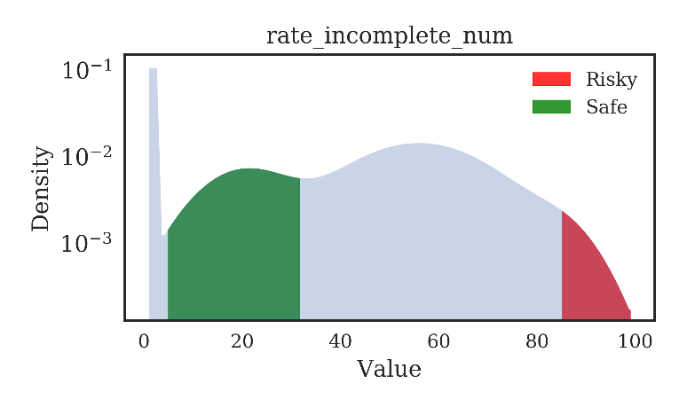
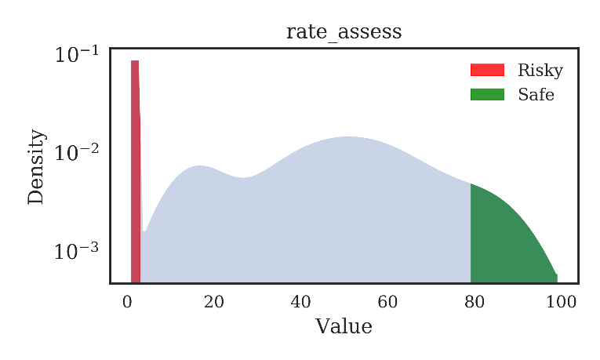
Feature Analysis (Why)
The mixture model methodology, by its nature, is designed for identifying clusters, but not explicitly for analysing feature importance.
However, by counting frequencies of components of risky and safe clusters, we can see how feature impacts churn outcome.
Risky cluster: churn rate > 50%
Safe cluster: churn rate < 5%
We can look at the component each cluster falls in for features.
Observations:
Subscribers having many incomplete lesson records are most likely to churn.
Subscribers taking few tutorials are most likely to churn

Slide 10


Prediction Workflow
How does Whizz use this model to predict the risk of churn for a set of subscribers?
Step I:
Train
Train Database
Model
Model Pipeline
Customised retention strategies:
Discount offers
Reminder of engagement
Etc.
Step II:
Predict
Model
2%
11%
CRM Team
19%
38%
67%
*Details of prediction accuracy performance will be discussed in the technical report.

Slide 11


Project Deliverables
Feature Extraction
Feature Distributional Modelling
Fitting Mixture Model
Analytics and Prediction
Pipeline
How to add new features?
Select features by industrial expertise
Add nonlinear transformation / interaction of existing features
Prototype Code
Whizz Database
I/O
(CSV ↔ pandas.DataFrame)
Configuration
ResearchConfig
Train
Predict
TestConfig
Feature Extraction
DataEngine
Feature Extraction
Feature Distributional Modelling
Fitting Mixture Model
FeatureEngine
FeatureConfig
FeatureGenerator
FeatureAggregator
ModelEngine
ModelParameter
GroupConfig
MixtureModel
Utility

